Slide 1
Laser Game Project
Alex Wheelock

Slide 2
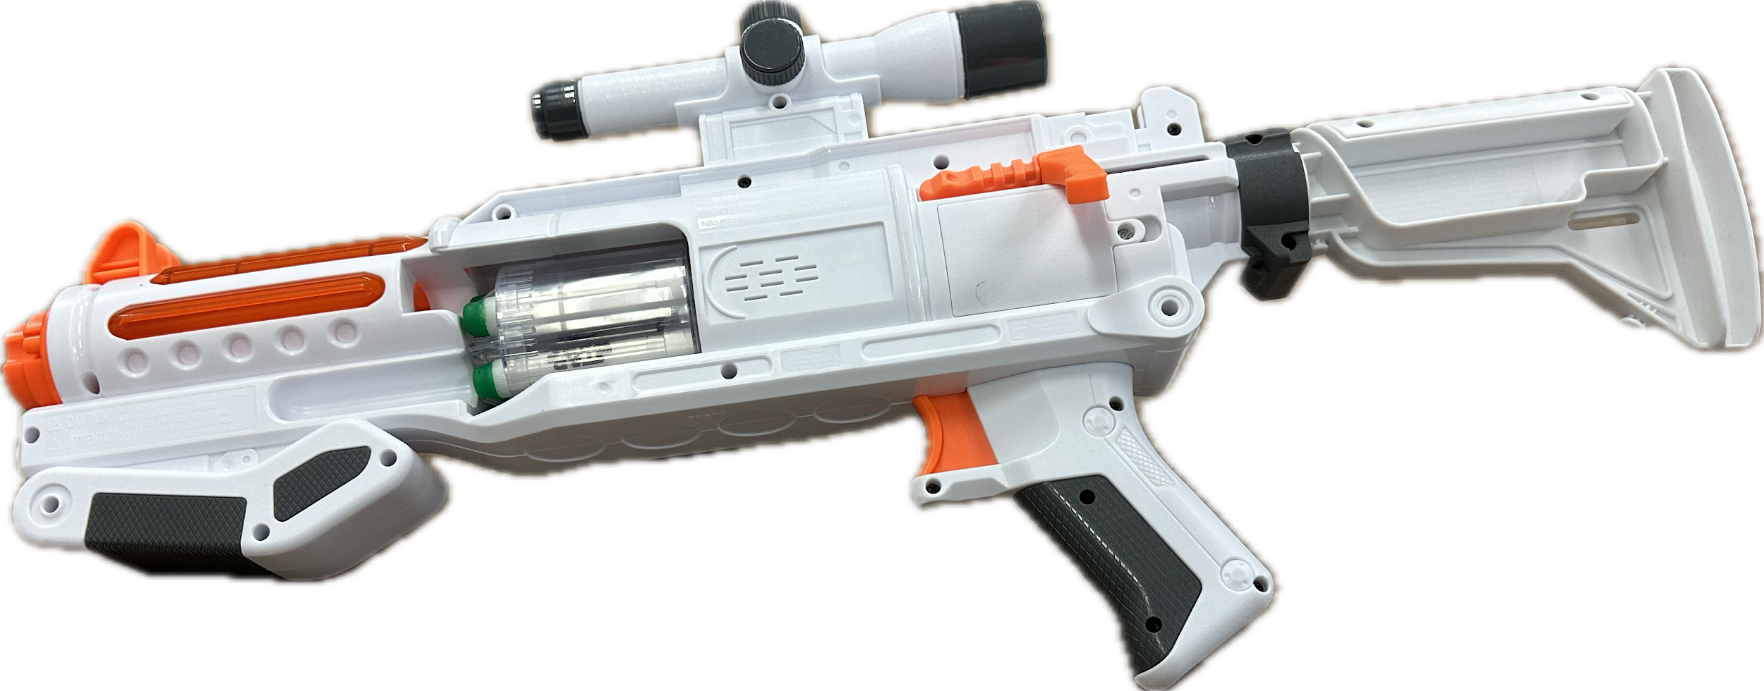

Slide 3
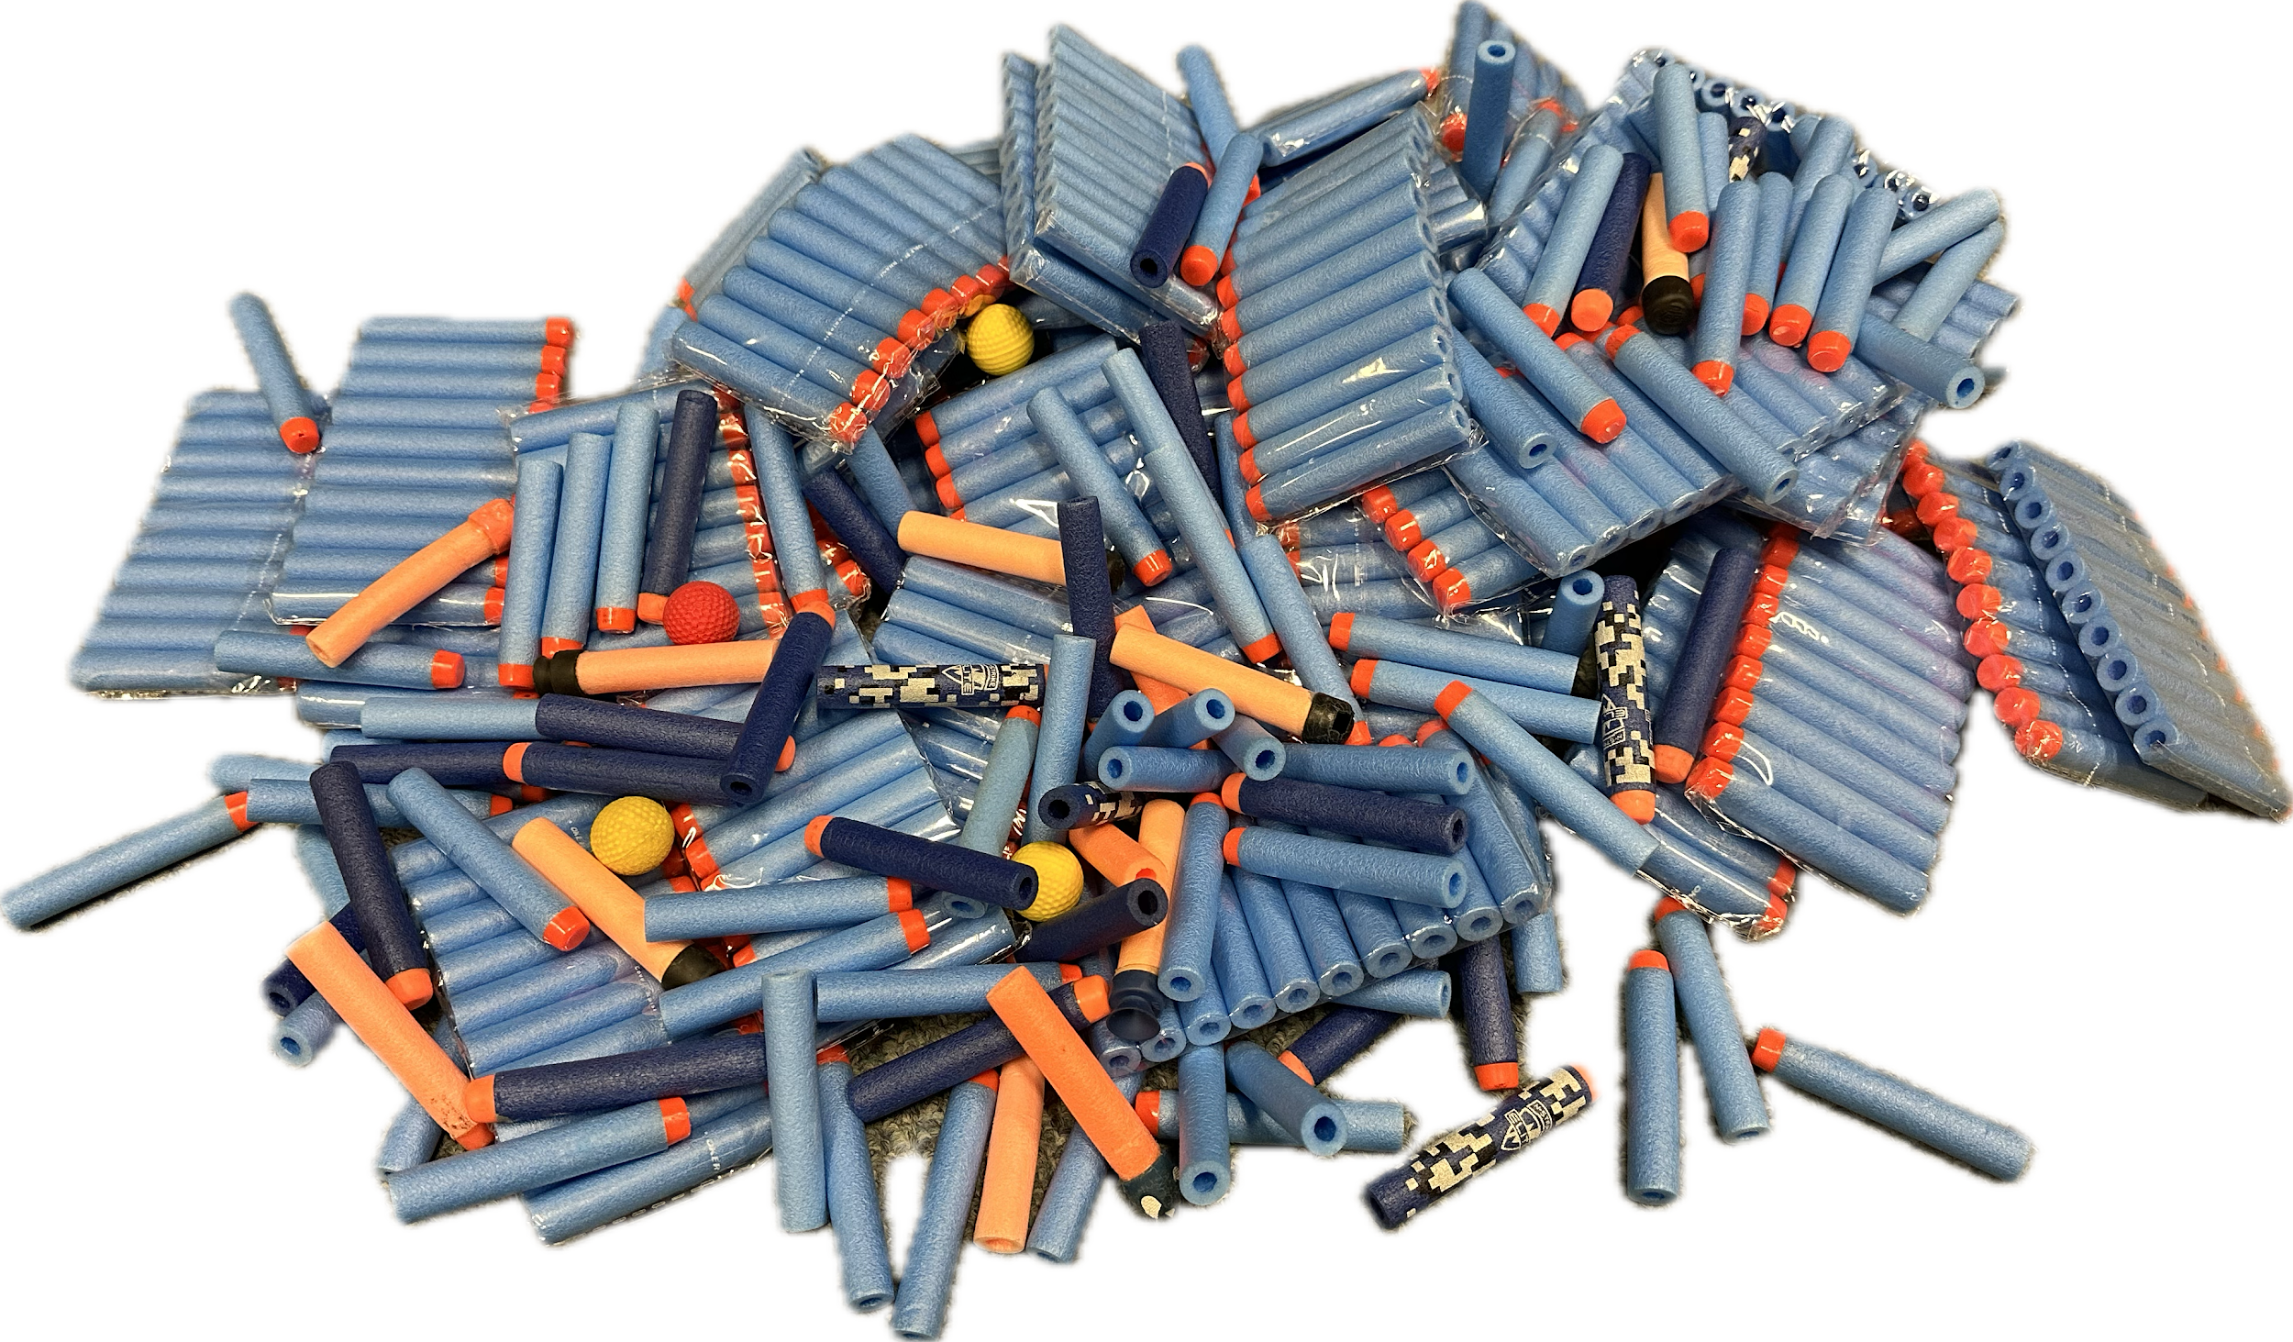

Slide 4
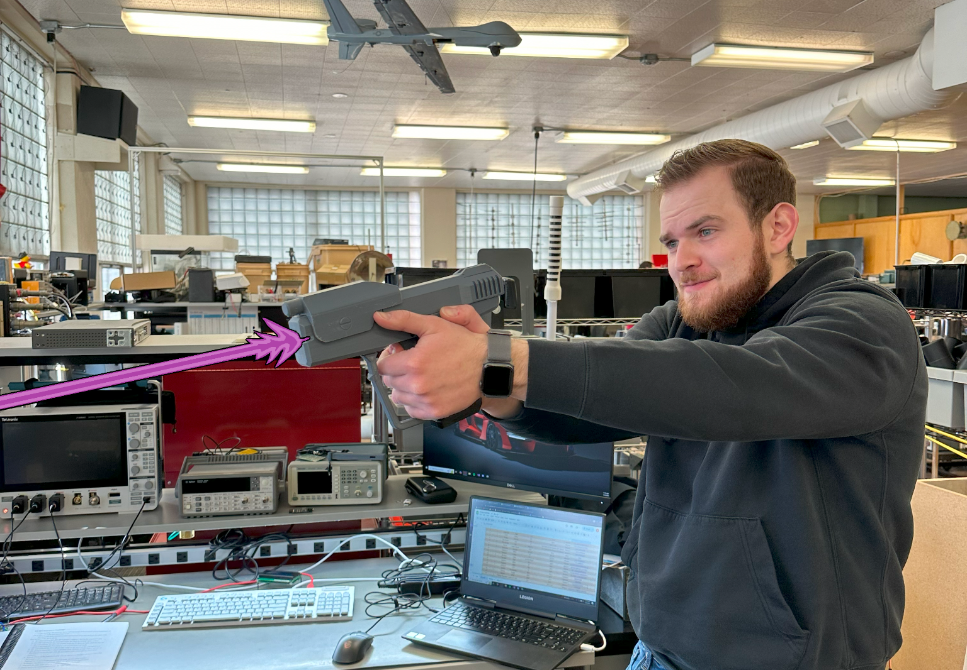

Slide 5
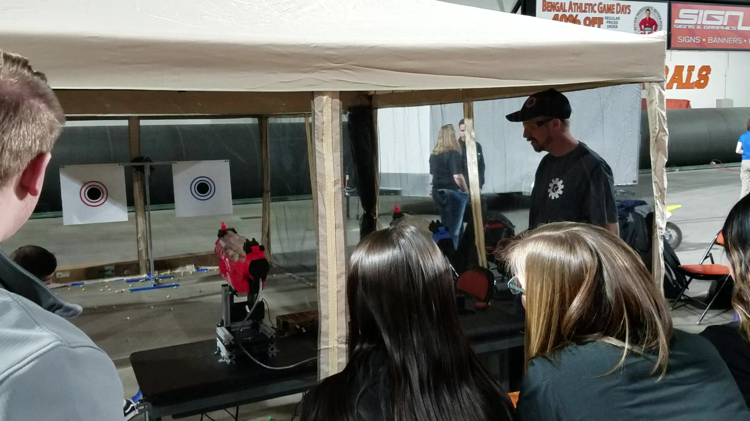
Image provided by Shane Slack

Slide 6
Laser Game
Removes the need for cleanup and reloading of darts
More reliable
Great recruitment tool for the ISU Robotics Program
Fun
Interactive
Hands-on
Give high school students a memorable experience to get them excited about electronics, and make the ISU Robotics program stand out from the crowd.

Slide 7
Semester Goals
Design and program a working prototype for the blaster, and target system.
Get an idea of how the project will come together and function.

Slide 8
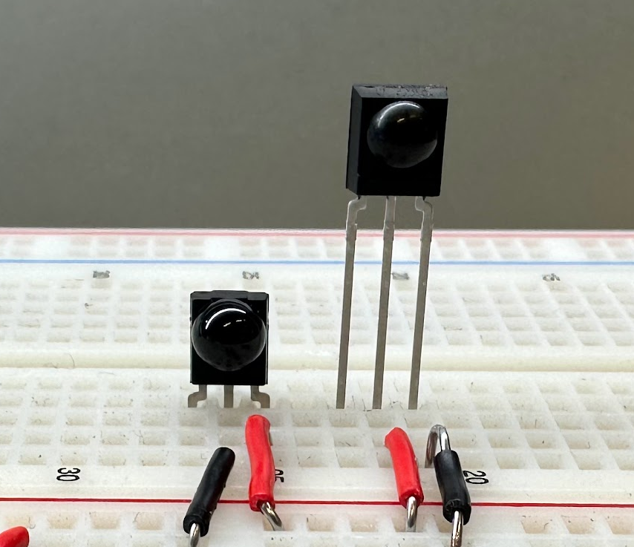
Receivers
TSOP32238
38kHz IR Receiver
TSOP53456
56kHz IR Receiver

Slide 9
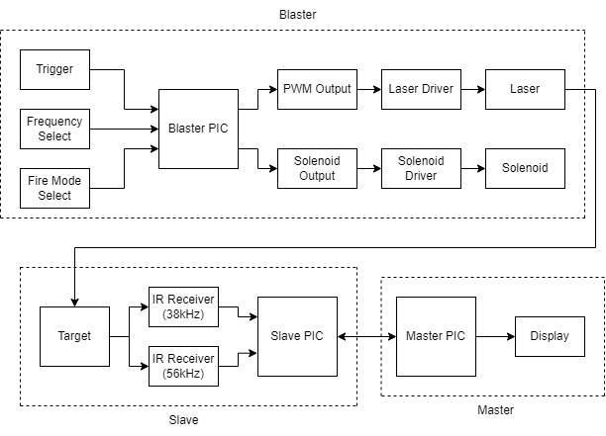
Block Diagram

Slide 10
Blaster Features
PWM Frequency Select Switch
Toggles between different player frequencies.
Fire Mode Select
3 Modes
Solenoid
Simulates cycling of slide & recoil of a real pistol.

Slide 11
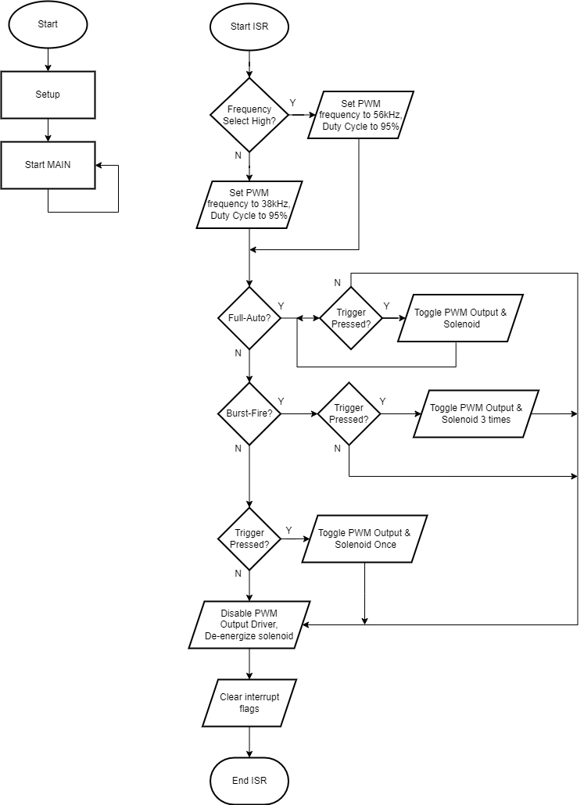
How does it work?
The PIC waits for an interrupt.
When an interrupt occurs, it determines what frequency and firing mode it is in.
It then checks if the user is trying to fire it.
If yes, the blaster will fire in the selected mode.
If not, the blaster will not fire, and leave the ISR.

Slide 12
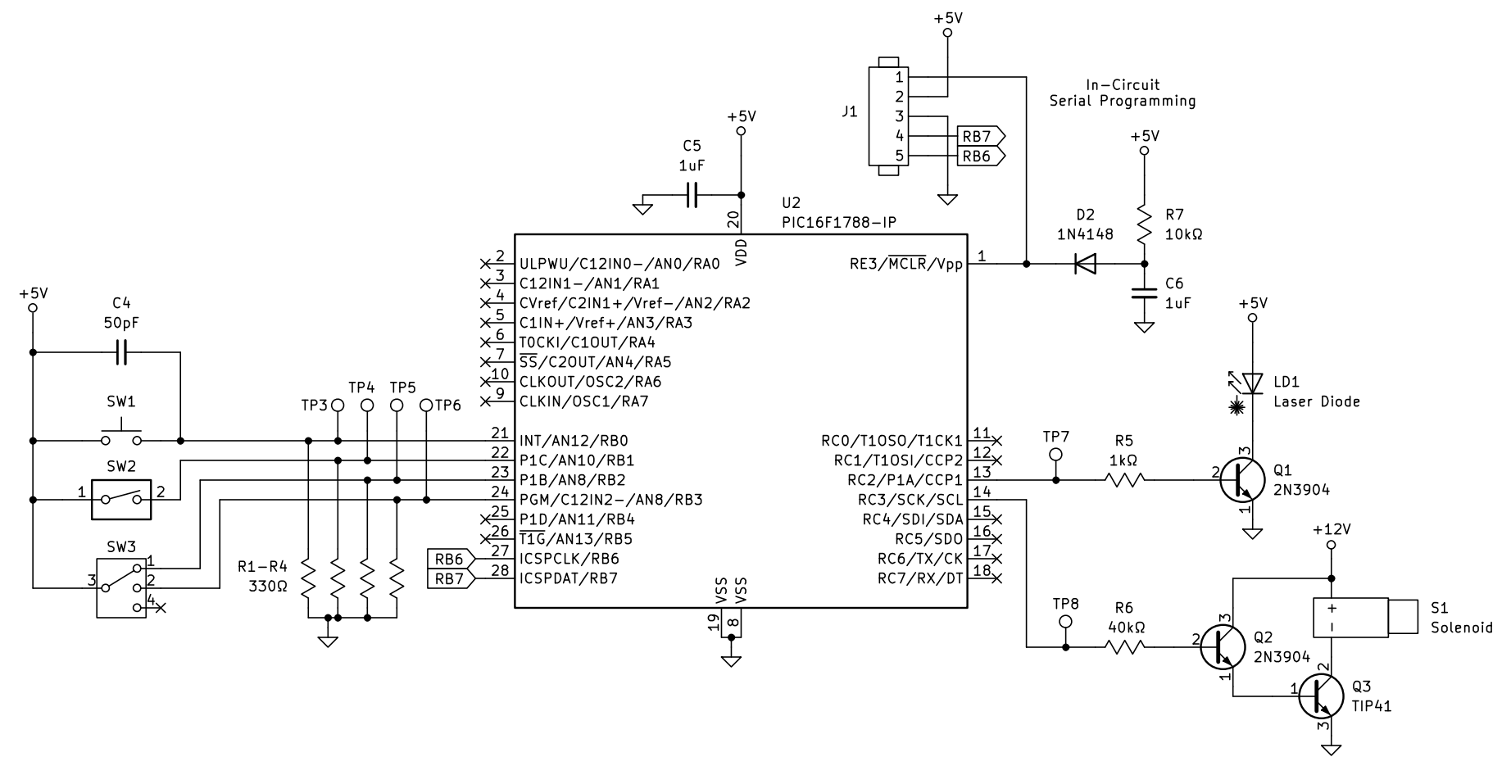
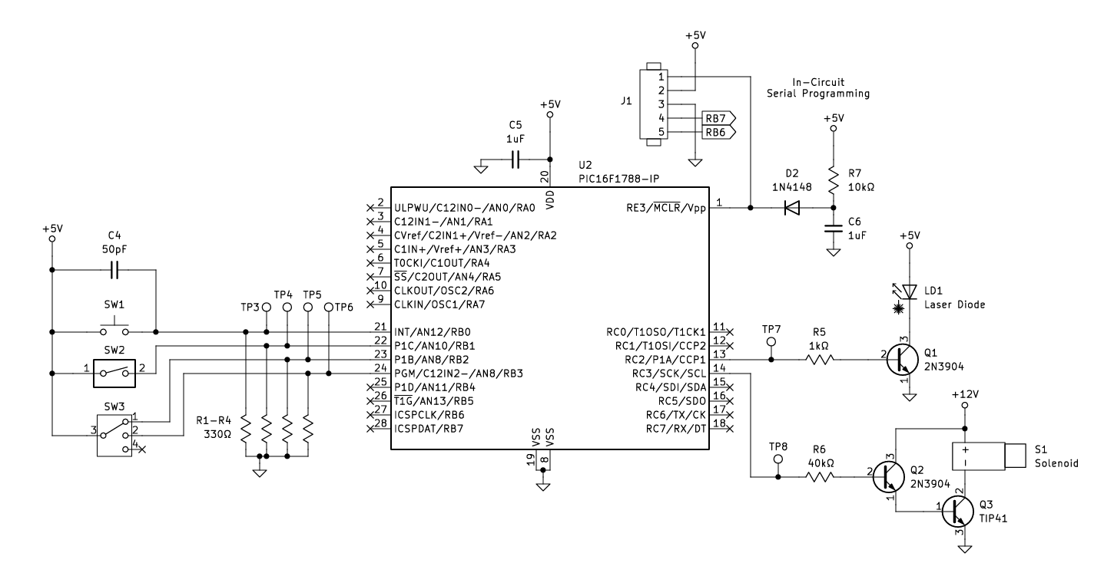
Blaster Schematic

Slide 13
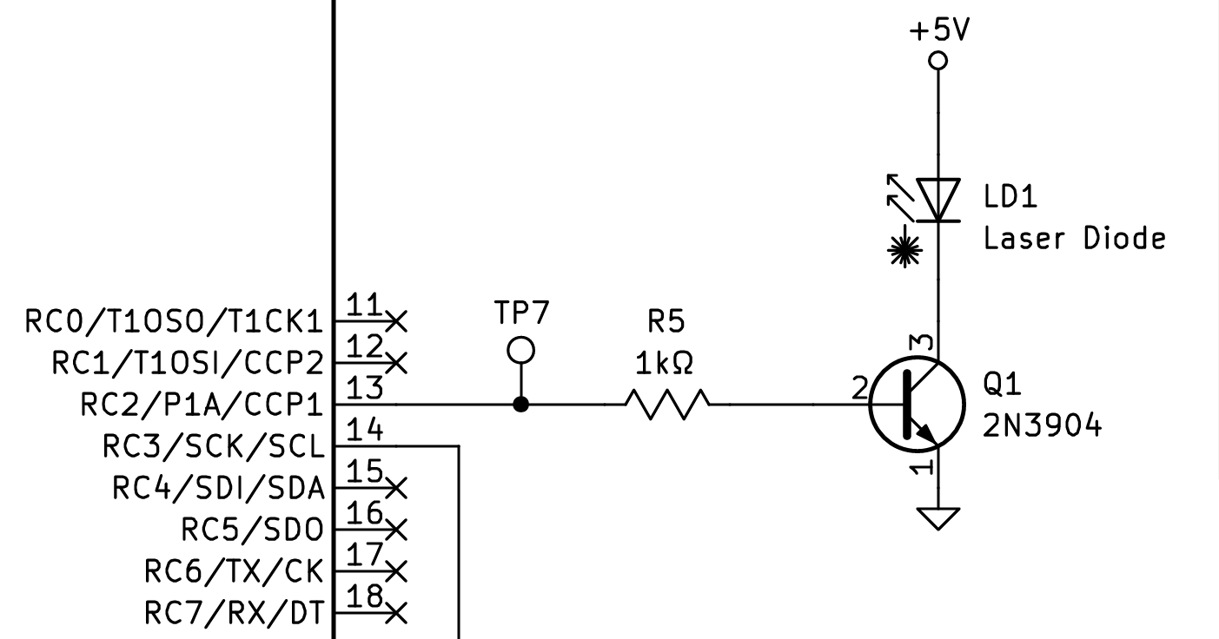
Laser/PWM Output
860mA
collector current
(max)
Pulls 24mA (measured)
4.3mA base current

Slide 14
Laser/PWM Output
Uses RC2 of the PIC (Pin 13)
Capture/Compare/PWM Module 1 (CCP1) is used. CCP1 is always on at the selected frequency with a 95% duty cycle for maximum laser brightness.
However, the output driver for PWM output is disabled by default, and only enabled while the blaster is firing (by the user pressing the trigger).

Slide 15
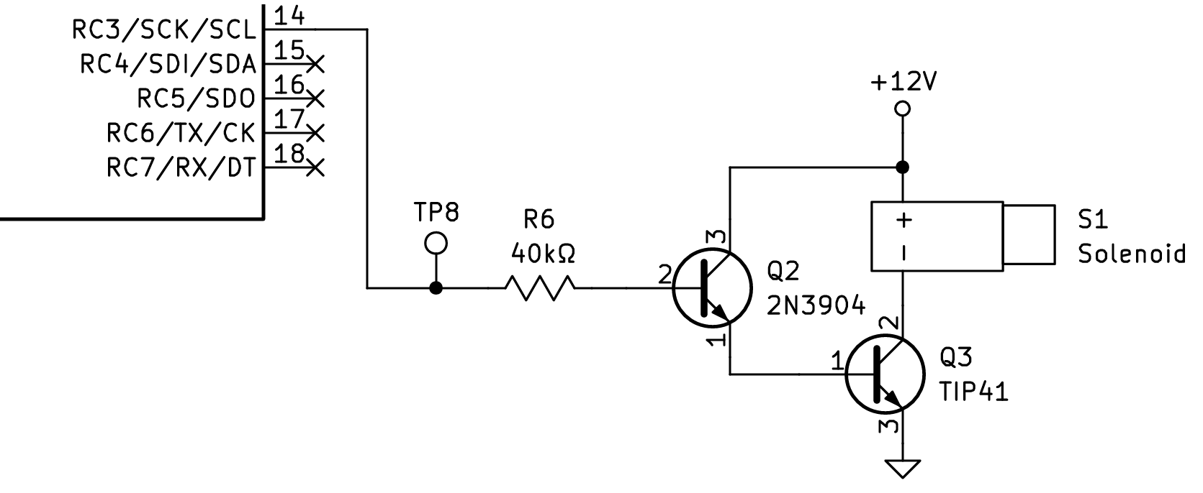
Solenoid Output
810 mA
Collector Current (Icsat)
90uA base current

Slide 16
Solenoid Output
Uses RC3 of the PIC (Pin 14)
Solenoid output works in tandem with the PWM output.
Enabled as the PWM output driver is enabled, so that the recoil is synchronized with the shot firing from the blaster.

Slide 17
PWM Frequency Select Input
The frequency of the laser PWM frequency can be toggled between 38kHz and 56kHz, allowing one blaster to act as either player 1 or 2 without requiring the PIC to be reprogrammed.
SW2 Position | RB1 | PWM Frequency
OFF | 0 | 38kHz (Player 1)
ON | 1 | 56kHz (Player 2)

Slide 18
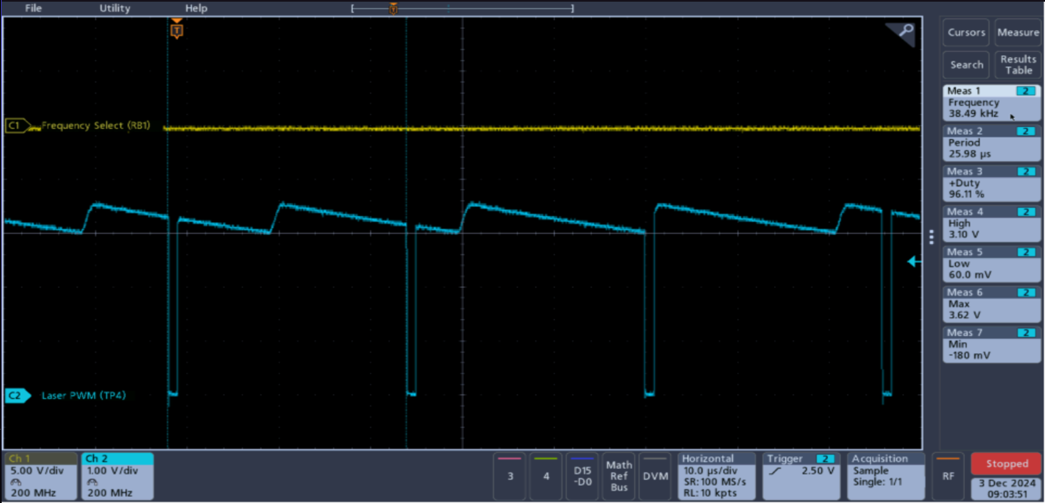
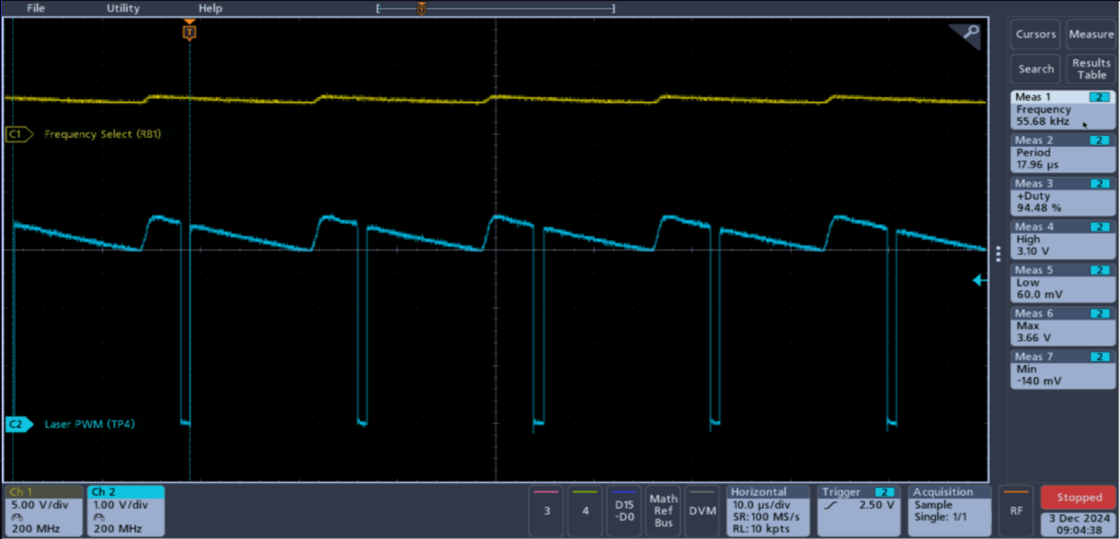
RB1 = 0 38kHz
RB1 = 1 56kHz

Slide 19
Fire Mode Select
Semi-auto: The blaster fires one pulse per trigger press.
Burst-fire: The blaster fires three pulses per trigger press.
Full-Auto: The blaster fires continuously, toggling the PWM output on and off as log as the trigger is being held down.
The timing is controlled by Timer 1, allowing the blaster to toggle the outputs every 65ms.

Slide 20
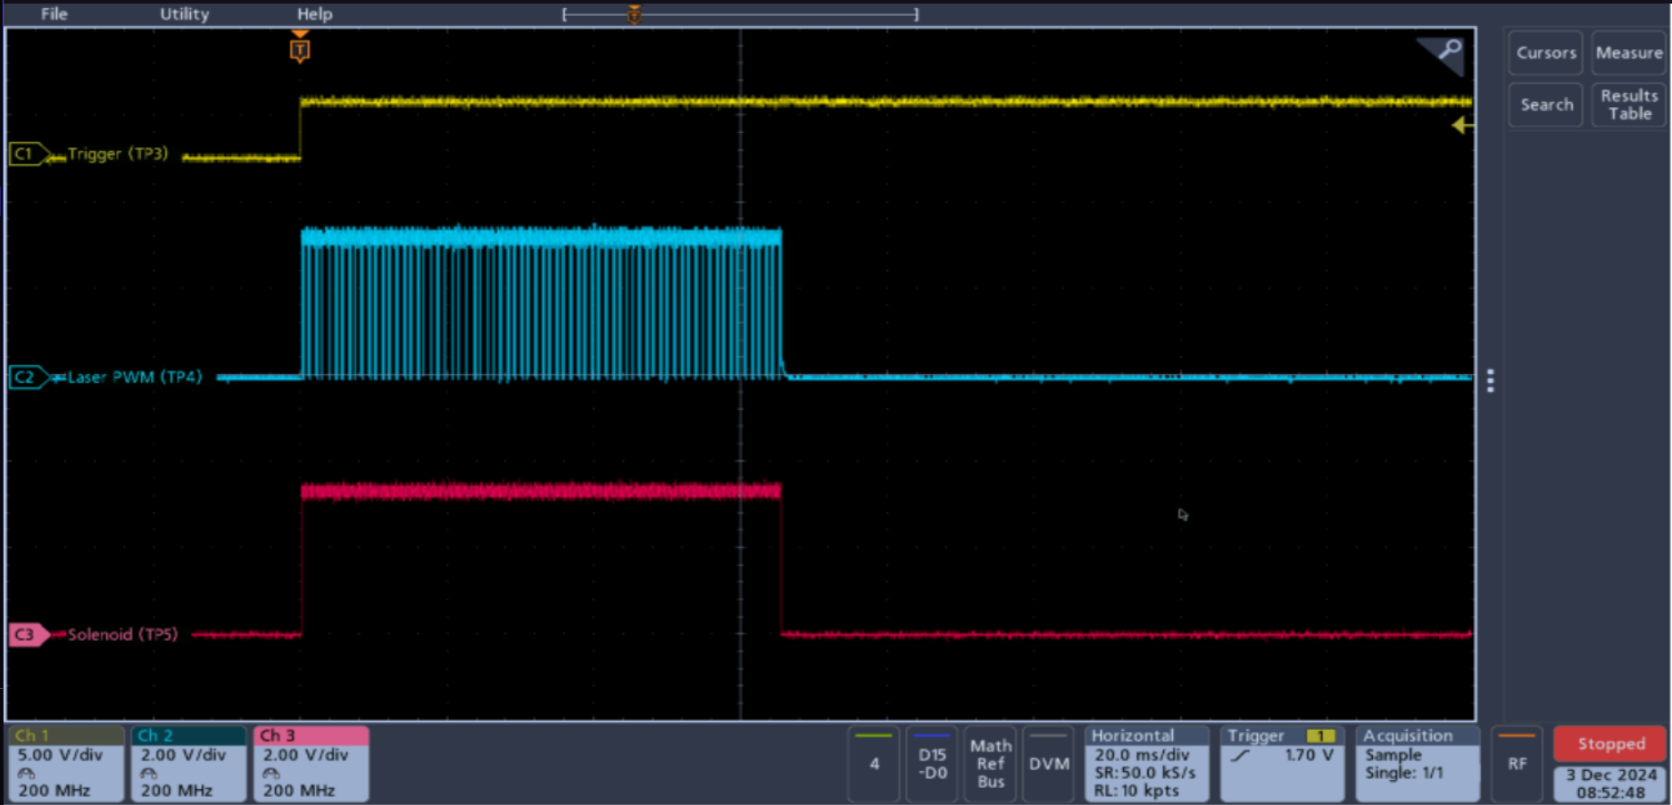
Semi-Auto
RB2 = 0, RB3 = 0

Slide 21
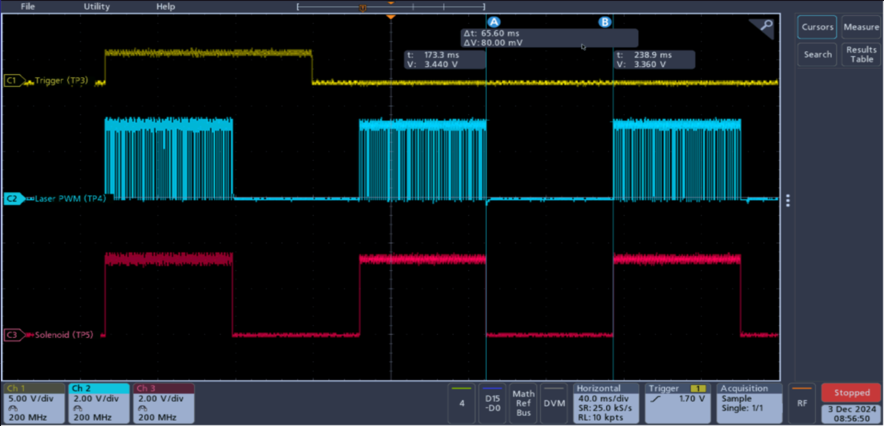
Burst Fire
RB2 = 0, RB3 = 1

Slide 22
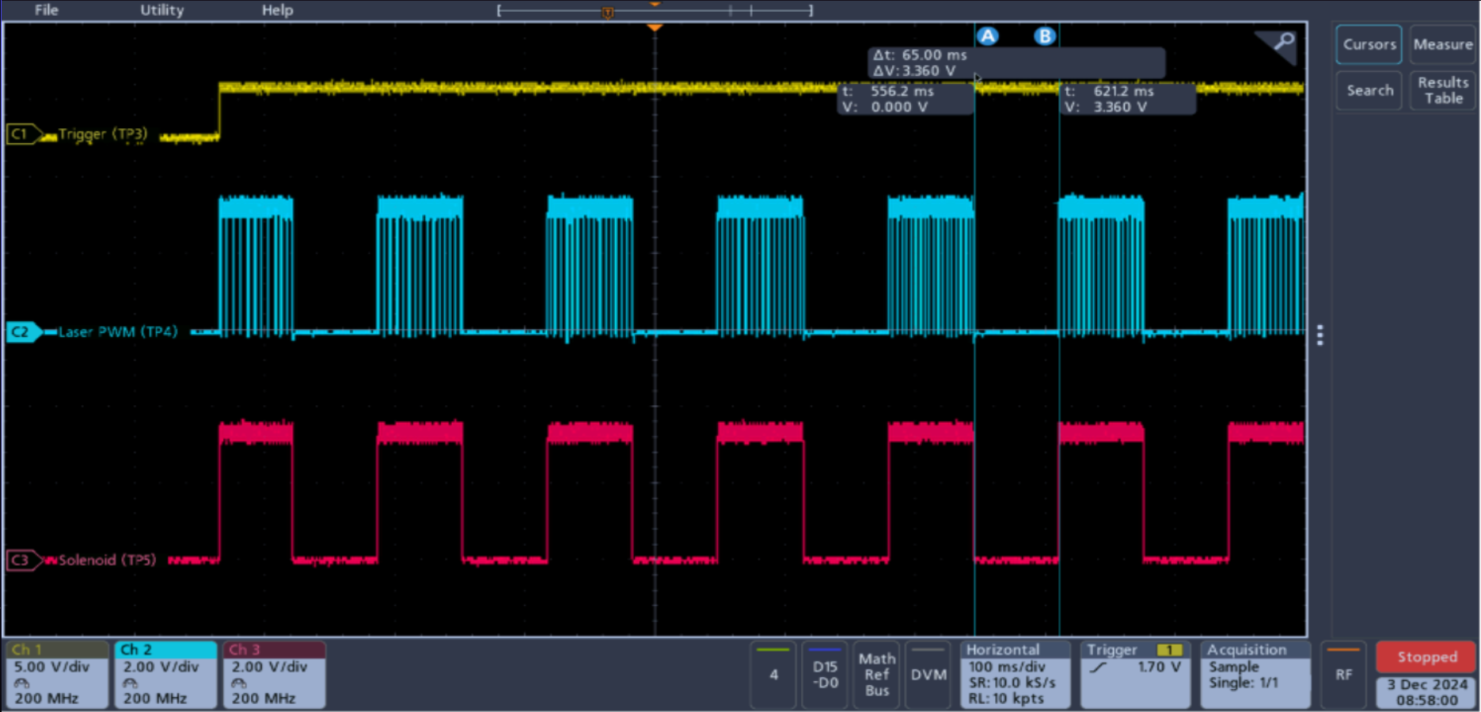
Full-Auto
RB2 = 1, RB3 = 0

Slide 23
Target System
Comprised of two circuits, the master and the slave which communicate via I2C.
The target system will enable random targets for players to shoot at, record hits, and relay the scores to the players.
Still in development, with the foundation laid out for future semesters.

Slide 24
Target Master Circuit
The master circuit is responsible for:
Supplies the slaves with power, ground, clock, and data lines.
Tells the slaves when to enable their target.
Polls the slaves to read when a target has been shot.
Keeps track of the score and time remaining in the game.
Displays the scores to the players.

Slide 25
Target Slave Circuit
Responsible for:
Enables the target and target enabled indicator LEDs when instructed to do so by the master.
Receives player hits from the blasters using the IR receivers.
Disables the target when hit.
Relays which player hit the target back to the master on the next read.

Slide 26
Engineering Log & Cost Analysis
Hours Worked: | 103.33
Cost/hr: | $50
Total: | $5,166.50
Wages: | 5,166.50
PCB Cost: (2 Blasters) (1 Master) (36 Slaves) | $330.58
Total: | $5,497.08
 | Single PCB
Blaster Cost: | $16.15
Master Cost: | $71.40
Slave Cost: | $7.09
Total | $94.64
*Price of PCBs not included, since
they have not yet been designed.

Slide 27
Conclusion
While expectations this semester were to get a working prototype of the blaster and the target system, those goals were not entirely met within the given time frame. While a working blaster prototype was achieved, the target system was unable to be built, programmed and tested.

Slide 28
Recommendations
Develop and program a working prototype for the target system circuits.
Find or create a target that allows both receivers to detect the laser
Design PCBs for the blaster, master and slave circuits.
Modify or design a chassis for the blaster.
Mount the targets/slave boards.

Slide 29
Questions?

